Slide 1


Infrastructure Outlook August 2023

Slide 2
"Infrastructure For Growth 2023"
Multi-year programs and outline for the development of Israel’s infrastructures.
Compiled by the Prime Minister's Office, the Ministry of Finance, with the help of all government ministries, and government companies
A list of infrastructure projects valued at more than 100 million NIS, construction to begin in the next 5 years.
Projects budgeted or approved by government
Several projects not yet approved, but examined financially - high probability for approval in the next 5 years.
Transparent and concentrated presentation of all significant investments in infrastructure in the country, funding and implementation methods, and implementation timetables.
This will encourage the entry of private investments and knowhow from Israel and around the world, increase competition, improve quality, and lower prices.
This is a governmental examination of the projects from a broad and strategic perspective, to help coordinate and improve planning and implementation
The proposed plans are the result of the work of many government entities: government ministries, government departments and government companies that appear in the program, the Prime Minister's Office, the Ministry of Finance

Slide 3
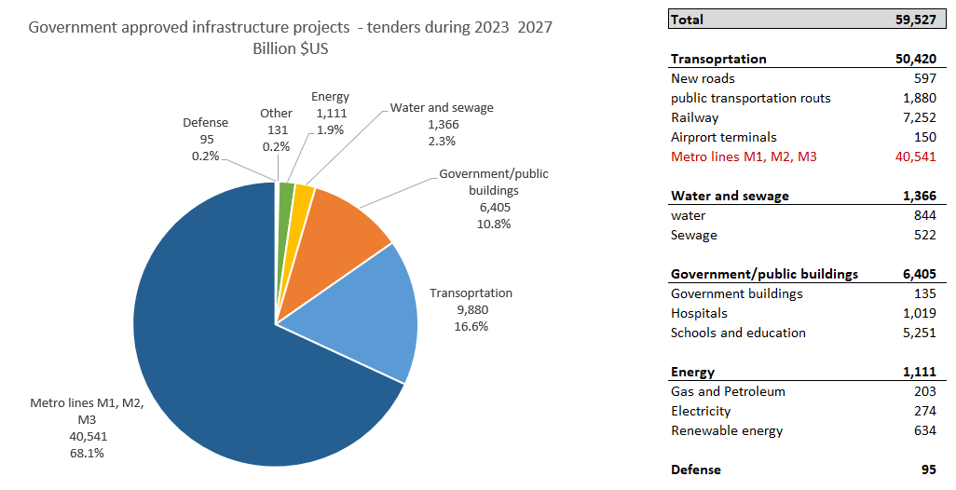
Government commitment to infrastructure spending
$60b
new infrastructure projects with approved budgets or PPP - tenders in 2023 - 2027
Source : Ministry of Finance

Slide 4
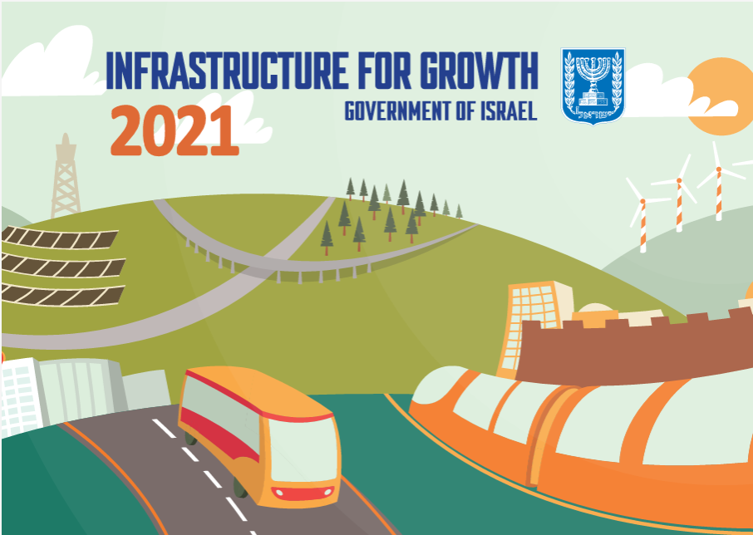
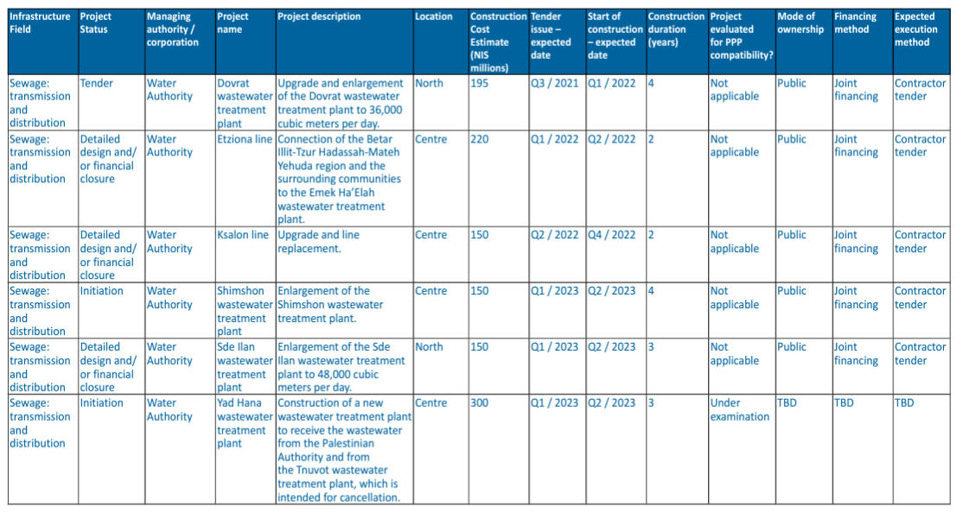
"Infrastructure For Growth 2023"

Slide 5
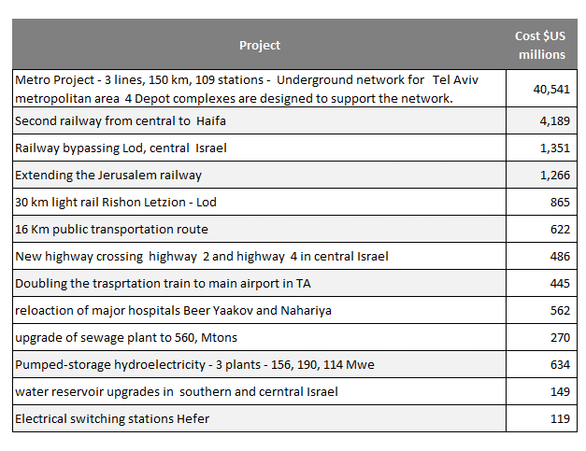
Upcoming projects and estimated budget ($US millions)
Examples of new infrastructure projects with approved budgets or PPP - tenders in 2023 - 2027
Source : Ministry of Finance

Slide 6
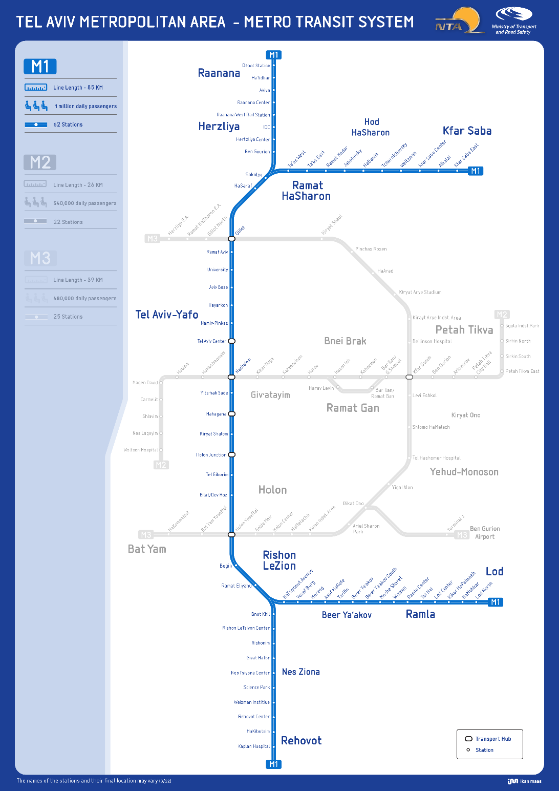
The Metro
Three Metro lines will extend and complete the mass transit system of Tel Aviv Metropolitan area and central Israel
The metro line network includes 3 lines with a total length of 150 km underground network in the Tel Aviv metropolitan area through 109 stations. Expected to serve 2 m passengers daily
The Objective is to establish a mass transit system that links surrounding towns to the center of the Tel Aviv Metropolitan Area and its major business centers.
Budget - $40B
PPP - TDB
Projected Economic benefits – $120B through 2040
First tender – 2024
First segment in operation – 2034
All lines operational – 2037

Slide 7
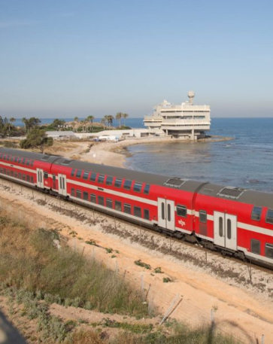
Second Coastal Railway line
A plan to double the coastal railways includes the addition of two new railways alongside the two existing railways with a length of 68 km, of which about 5 km are in the coastal environment.
Two of the tracks will be used by high-speed trains at a speed of 250 km/h, which will allow a train ride within half an hour between Haifa and Tel Aviv, and they will be partly underground; and two for suburban trips.
Budget - $4B
PPP - No
First tender – ?
First segment in operation – ?
Source : Ministry of Finance

