Slide 1


Israel Builders Association & The Israeli Construction Sector
August 2023
Ziv Lazar, Economist ziv@acb.org.il

Slide 2




The Israel Builders Association (IBA)
The Israel Builders Association (IBA)
The only official organization of construction sector members in Israel. Established 1949. Incorporates 13 local Associations
3,000 members – contractors & developers for home building, infrastructure and all other construction work
Represents the sector interests with government ministries and agencies, local authorities, Bank of Israel, Standards Institute, CBS, etc.
Represents the employers in the collective labor agreement with the General Organization of Workers. Operates a Bipartite Mediation Committee for employers and workers.
Plans and oversees on-site assessment of foreign workers to be employed in Israel - molding, masonry, flooring, plastering
Founded CONTECH - Construction-tech hub connecting startups with the construction and real estate industries, assisting with product-market fit and helping secure investments
With over 3000 members, the association representative organization dealing with the Israeli markets’ construction, infrastructure, development, and engineering issues.

Slide 3
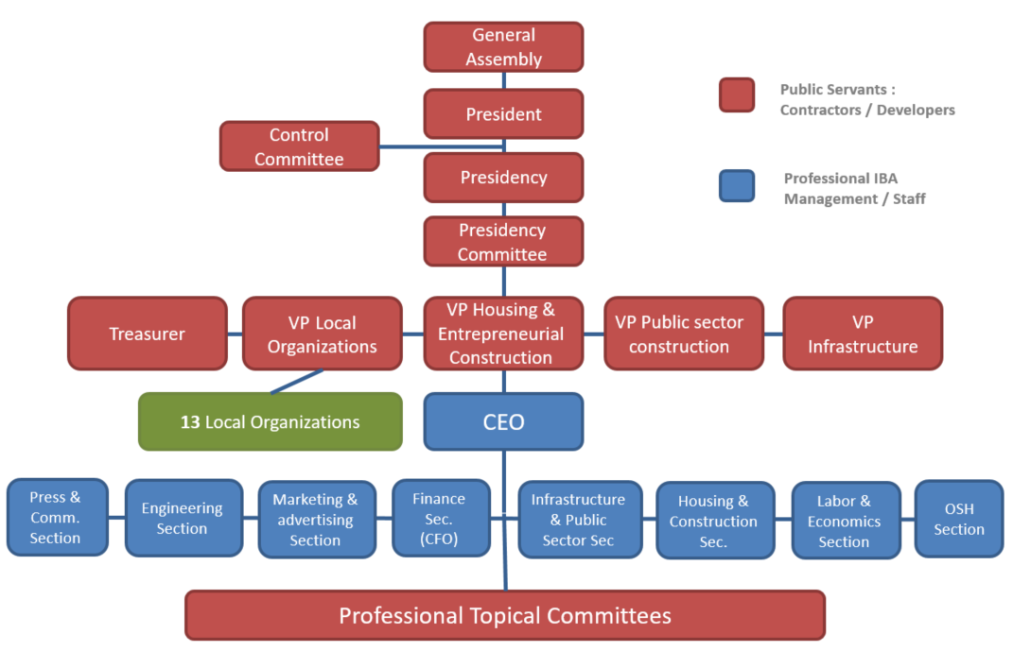
The Israel Builders Association (IBA)
The Israel Builders Association organizational chart
With over 3000 members, the association representative organization dealing with the Israeli markets’ construction, infrastructure, development, and engineering issues.

Slide 4


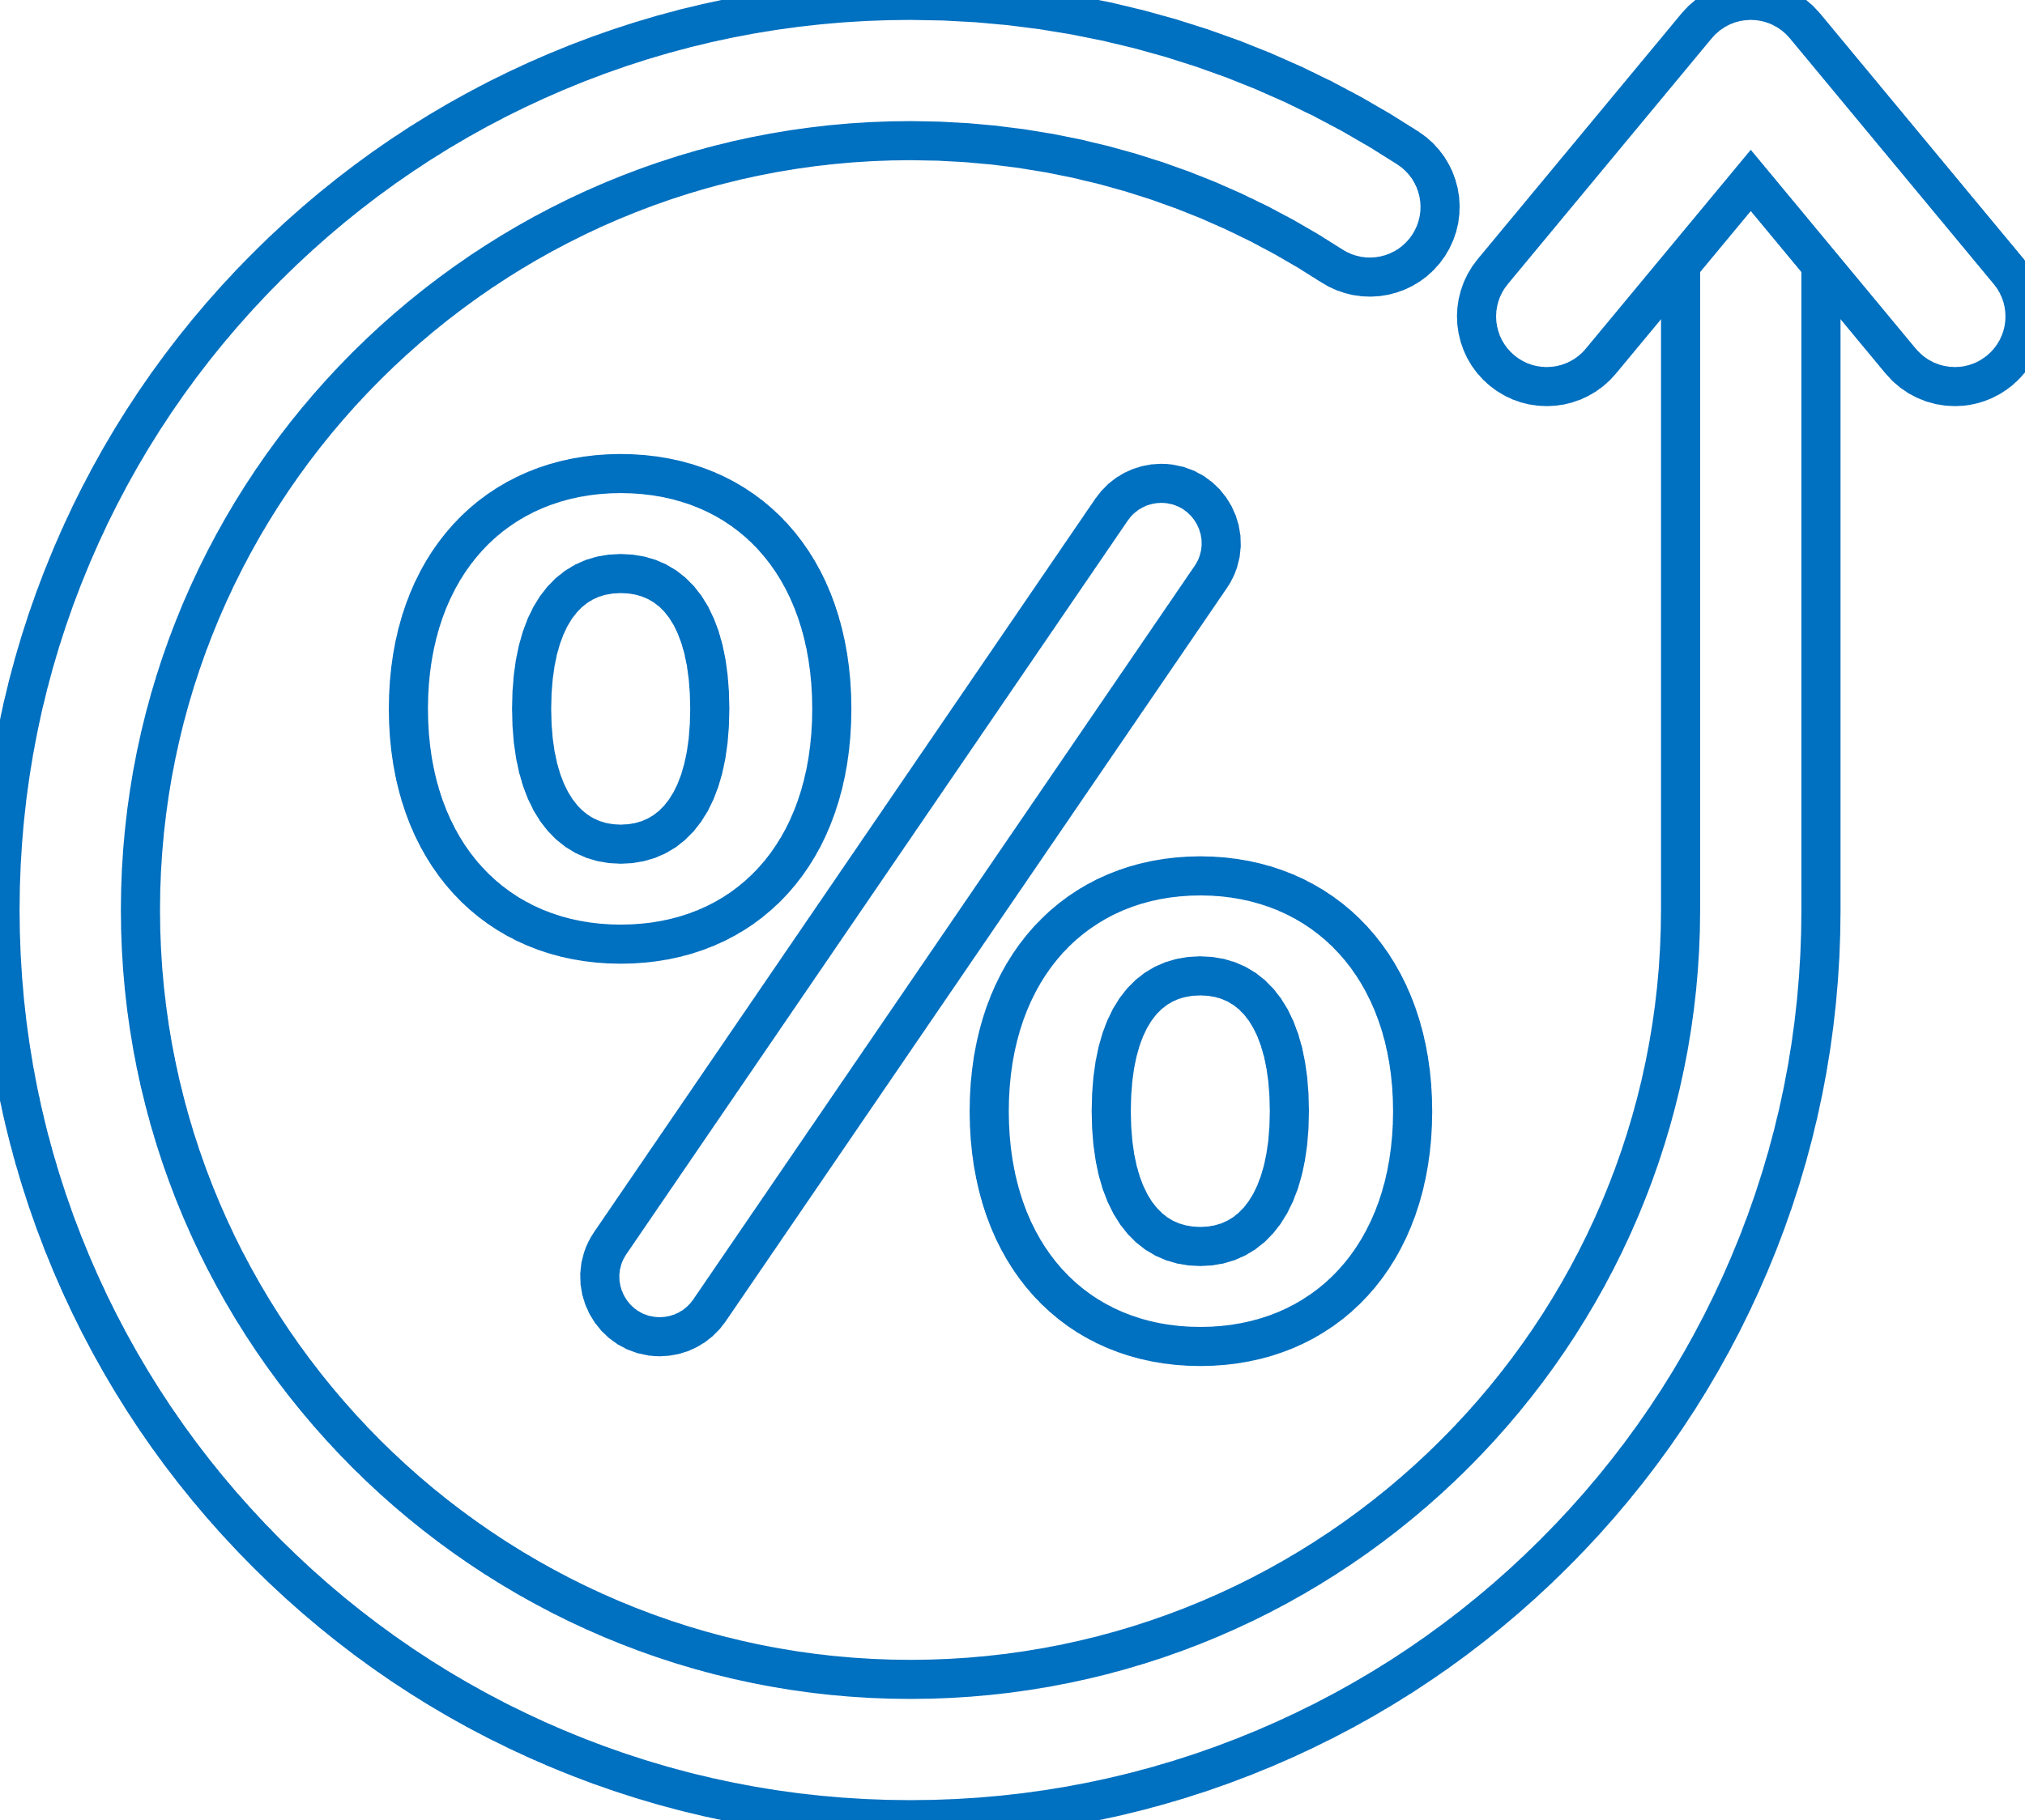





Israel - Business and Macro Environment
22,000
sq km
3.1%
Unemployment
4.75%
BOI Interest Rate
9.7m
Population +1.8%
+2.7%
Avg. real wage growth
65%
Government Debt as part of GDP
$485b
GDP
+6.5% (2022)
5%
Inflation

Slide 5
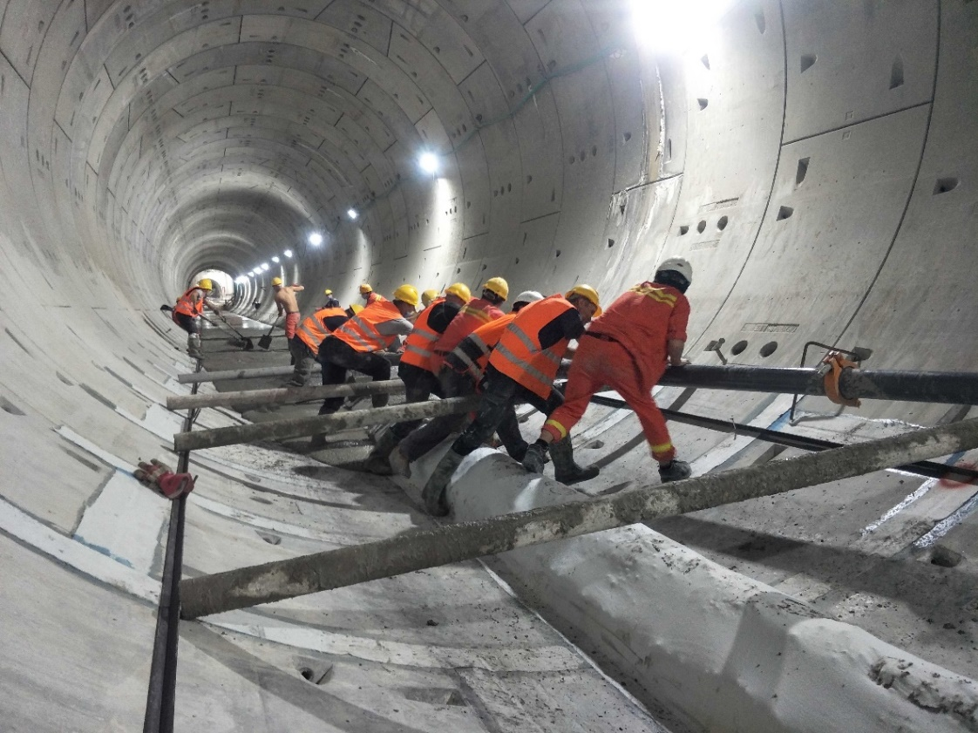

Israeli Construction Sector Size
Gross Domestic Investments in Construction, Billions US$ 2022
$65b
Total construction sector investments
$10.7 b
$19.0 b
$35.3 b
13.4%
Share of GDP
+5.5%
Average growth per year
Source : Central Bureau of Statistics

Slide 6







The Housing Sector in Numbers
67%
Household home ownership
130,000
housing transactions per year – 38% new
50%
of housing are in Tel Aviv and central Israel
$685,000
Average price per new dwelling
93%
Government land ownership
75%
of new housing units are flats in cities
4-5 rooms/110 sqm
Living space in mid-rise buildings Most multi-family flats

Slide 7
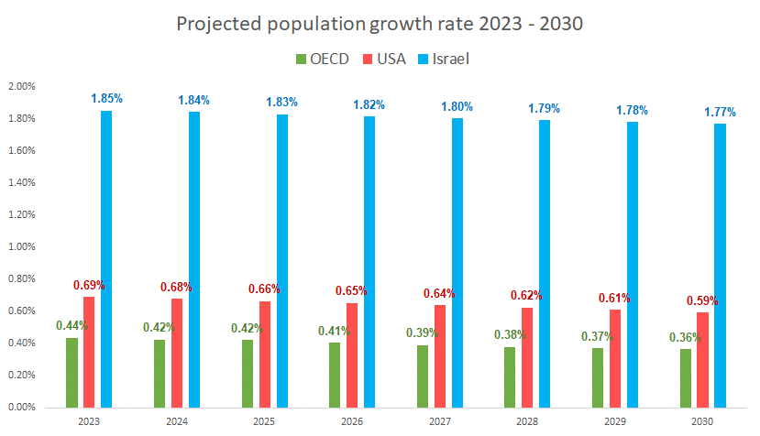
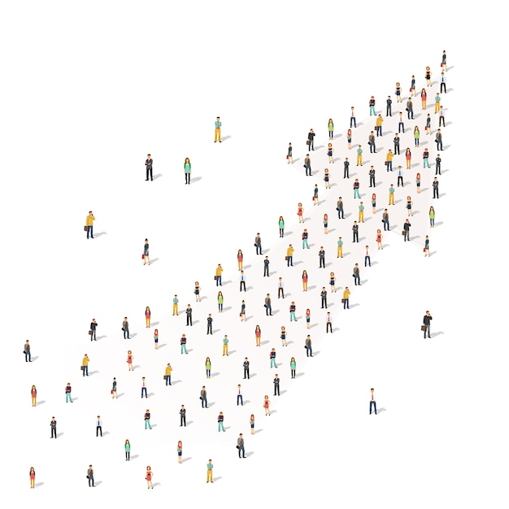
Government commitment to infrastructure spending
Israel’s population is expected to double by 2060
Source : OECD

Slide 8
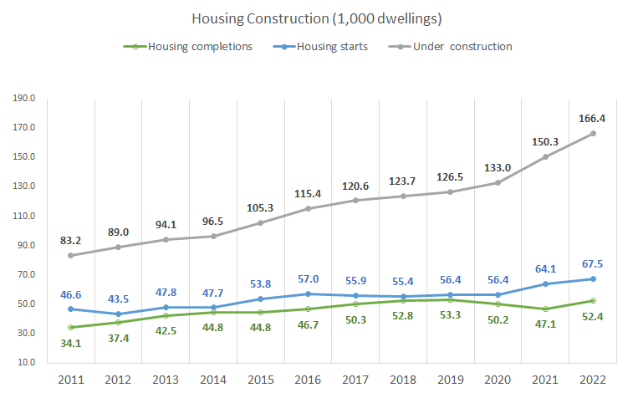
Housing Starts and Housing Completions in 1,000 units
67,500
Housing starts (2.3% of housing stock)
52,400
Housing completions
Source : Central Bureau of Statistics

Slide 9
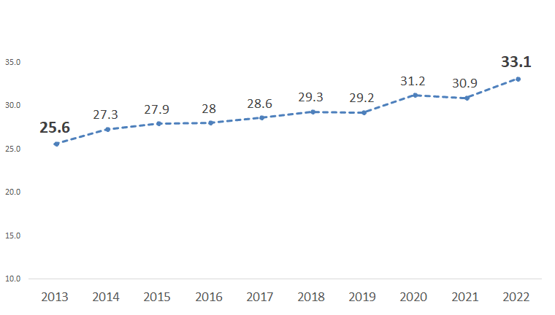

Long Construction Times construction time per avg. housing unit in months
+7.5
months
Source : Central Bureau of Statistics

Slide 10
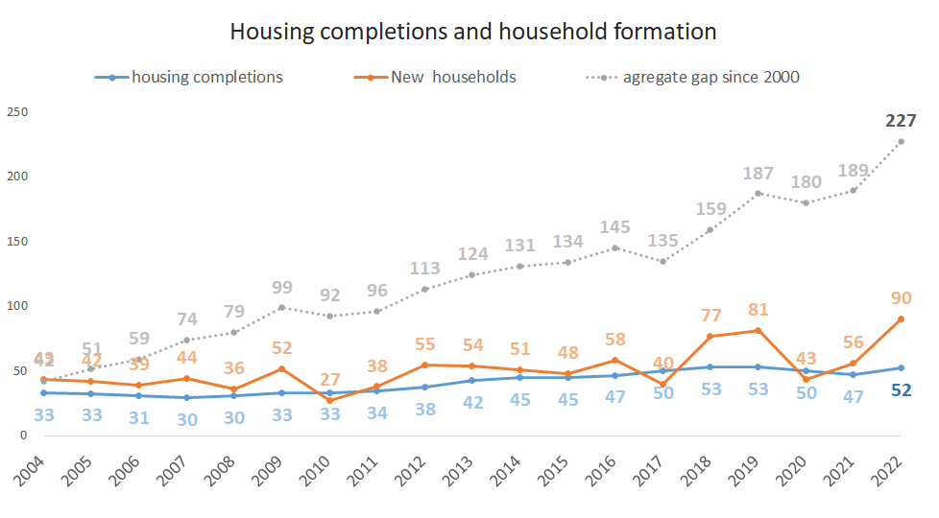
The housing shortage:
Constant gap between supply and demand
Average yearly housing shortage:
10,000 units / 20% of new households
60,000
Avg yearly new households
50,000
Avg housing completions
Source : Central Bureau of Statistics, IBA calculations

Slide 11
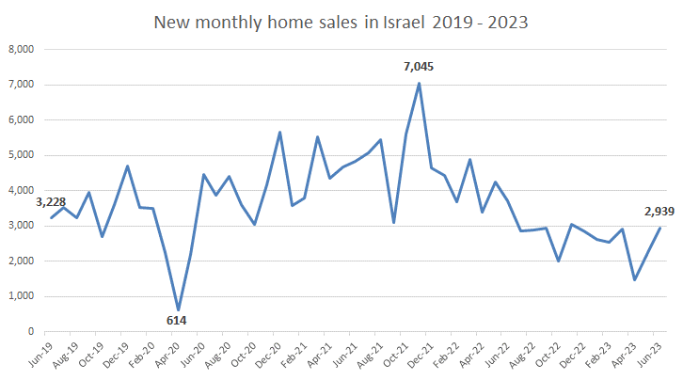
The housing market
The cooling effect if interest rates
New home sales in 2023 are back to 2019 levels
40% drop from 2022 levels
Source : Central Bureau of Statistics

Slide 12
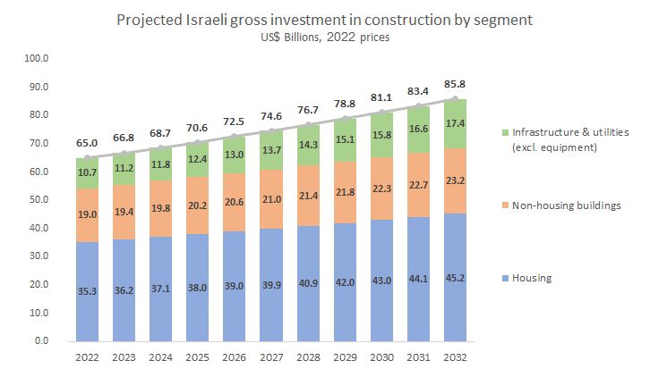
Projected Market Growth
Projected Israeli gross investment in construction by segment (US$ Billions, 2022 prices)
+5.0%
projected yearly growth in Infrastructure
+5.0%
projected yearly growth
non housing buildings
+2.5%
projected yearly growth in housing
+32%
projected growth for the next decade
Source : Central Bureau of Statistics, and IBA projections based on population growth and government infrastructure plan 2021

Slide 13



Labor Force - Foreigners
More than half of foreigners and from China
Source :Population and Immigration Authority

Slide 14
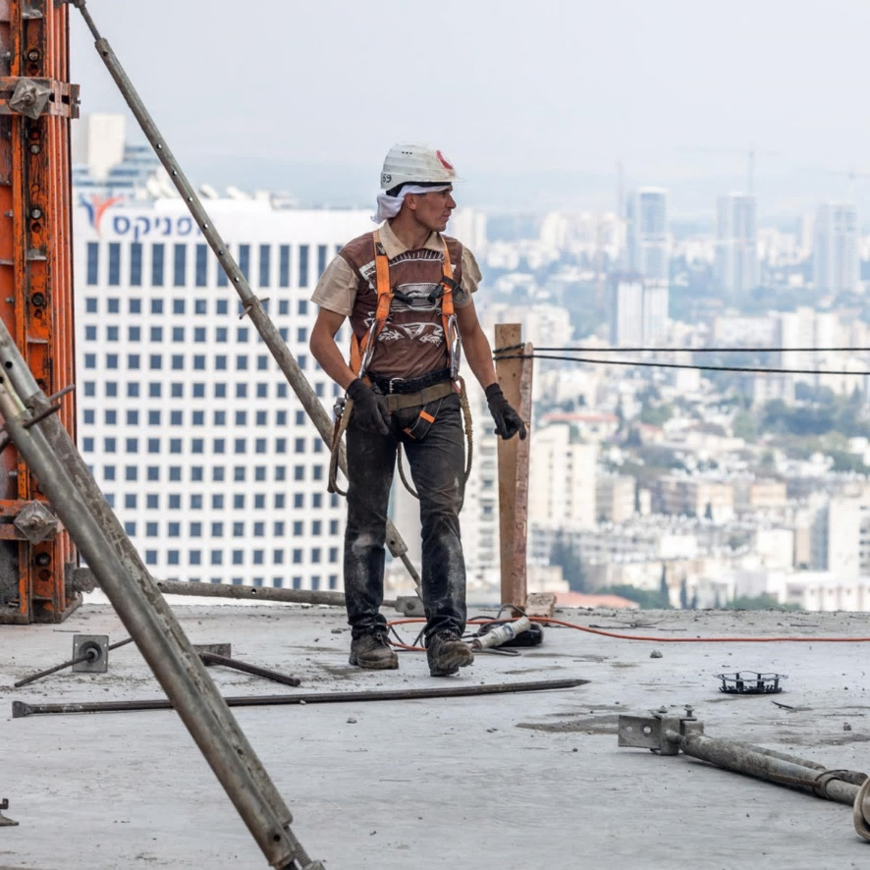
Labor Force
70% Israelis, 22% Palestinians, 8% foreigners
Sources : CBS, Ministry of Interior

